Slide 1
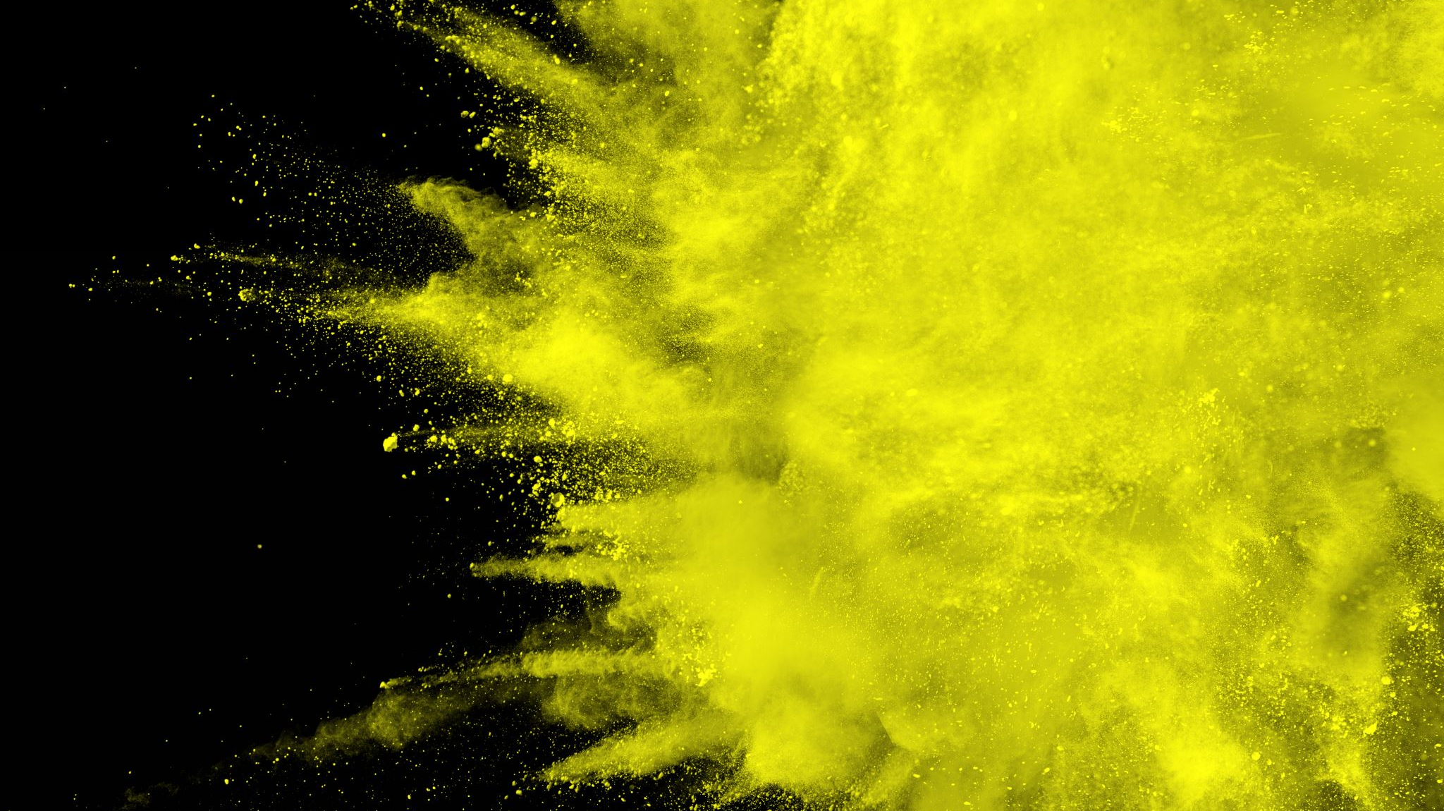
Energy profile diagrams review
A review of energy profile diagrams including activation energy

Slide 2
Activation energy
The minimum energy that colliding particles must have in order to react is called the activation energy.
You can think of the activation energy for a reaction as a barrier that reactants must cross before products can form.
As reacting particles approach each other, repulsive forces between electron clouds causes them to slow down and lose kinetic energy
This lost kinetic energy converts to increased potential energy of the colliding particles
If they have enough kinetic energy they will approach close enough (collide) to form a transition state also known as the activated complex – the highest potential energy state

Slide 3
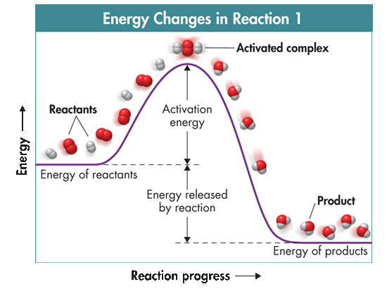
Activation energy
The activation-energy barrier must be crossed before reactants are converted to products.
Exothermic or endothermic?

Slide 4
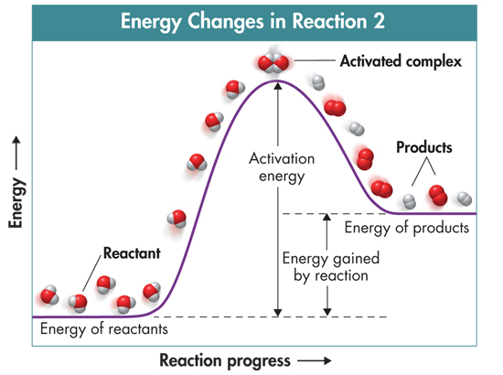
Activation energy
Exothermic
Endothermic

Slide 5
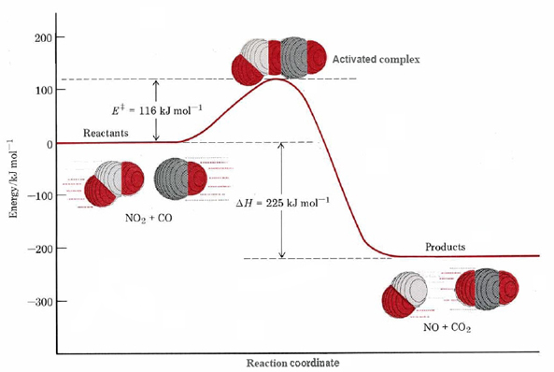
Transition state
The transition state is where the original bonds are being broken and new bonds are being formed
It is an unstable arrangement; its brief existence ends with the reformation of the reactants or with the formation of products
The minimum collision energy required to form the transition state is known as the activation energy Ea

Slide 6
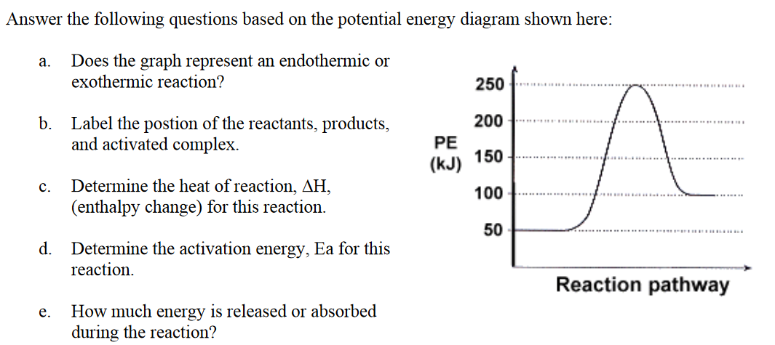
Understanding check

Slide 7
Understanding check
Transition state
Endothermic
Ea
products
∆H = + 50 kJ
∆H
reactants
Ea = 200 kJ
50 kJ of energy is absorbed in the reaction

